Slide 1

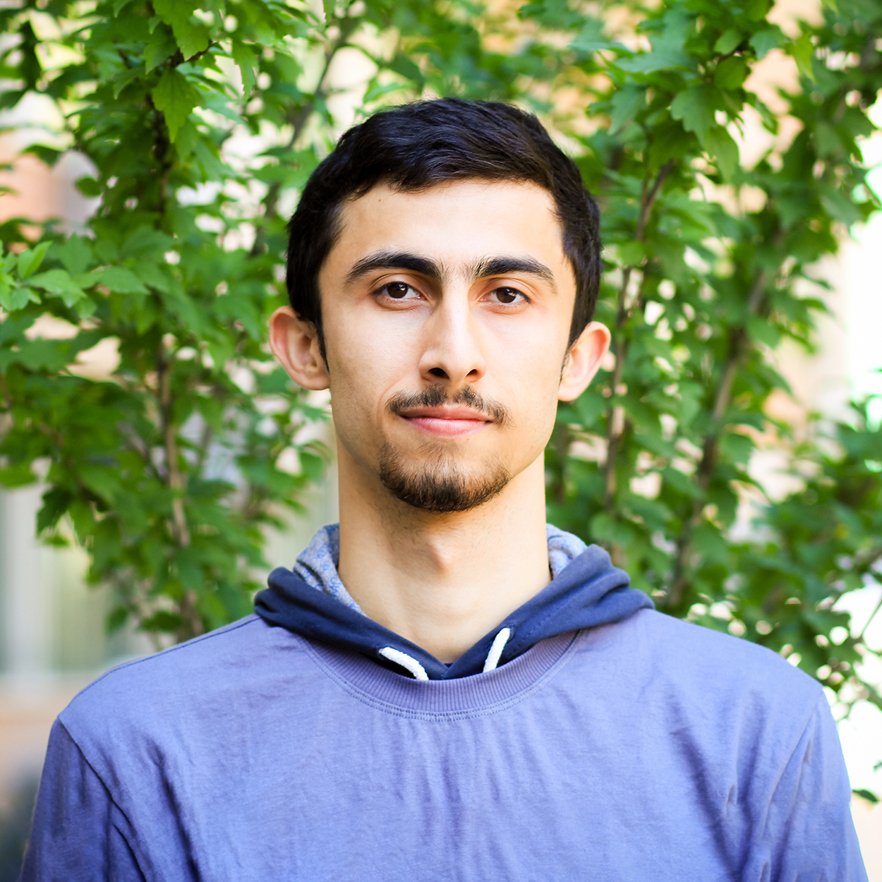



Permissioned Blockchain Through the Looking Glass: Architectural and Implementation Lessons Learned
Suyash Gupta
Sajjad Rahnama
Mohammad Sadoghi
MokaBlox LLC
Exploratory Systems Lab
University of California, Davis

Slide 2
What is Blockchain?
New
Block
Previous
Hash
Genesis
Previous
Hash
Previous
Hash
Data
Data
Data
Client Transactions
Linked List of Blocks
Hash of Previous Block

Slide 3




Why Blockchain?
Democracy
Decentralization
Authentication
Security
By User:Pedant, User:Wapcaplet, User:Antonu, User:Vanderlindenma, User:.js. - Composition of File:Barnstar of Diligence Hires.png + File:Voting hand.svg., CC BY-SA 3.0, https://commons.wikimedia.org/w/index.php?curid=45960536

Slide 4
Components of a Blockchain System

Slide 5


Data 1
Data 2
Data 1
Data 2
Data 1
Data 2
Data 1
Data 2
Replicas

Slide 6


Clients

Slide 7


At the core of any Blockchain application is a Byzantine Fault-Tolerant (BFT) consensus protocol.
OK
OK
Order Txn
OK
Consensus

Slide 8





Cryptographic Constructs
Digital Signatures
Collision Resistant Hashing

Slide 9












Blockchain Applications
Cryptocurrencies
Project Tracking
Waste
Management
Energy Trading
and Management
Healthcare

Slide 10
Why only Cryptocurrencies?
Throughput of initial “blockchain”cryptocurrencies → < 10 txns/s.
Throughput of existing distributed databases → 1 million txns/s.
Low throughput acceptable in permissionless applications.

Slide 11
Permissionless
vs.
Permissioned

Slide 12
Permissionless Blockchains
Multiple simultaneous proposers →
Blockchain Forks
Require computing complex hashes.
Open Access: Anyone can participate
Cryptocurrencies: Bitcoin & Ethereum
Wastage of Energy
Identities of the replicas are unknown
Fastest hash computer → Proposes block

Slide 13






Permissioned Blockchains
Identities known a priori.
High Communication → Low Scalability
Often cited reason → BFT consensus protocols are expensive!
Applications: Blockchain Databases, Healthcare…
Computationally cheap
Throughput still low → < 10Ktxns/s
Employ traditional BFT consensus:
PBFT, Zyzzyva, SBFT…

Slide 14
Can a well-crafted system based on a classical BFT protocol outperform a modern protocol?
60%
ResilientDB employs PBFT → two phases of O(n²) communication!

Slide 15
Existing Permissioned Blockchain systems overlook system design!
ResilientDB adopts well-researched database and system practices.
Visit at: https://resilientdb.com/

Slide 16
Dissecting existing Permissioned Blockchain
Single-threaded Monolithic Design
Successive Phases of Consensus
Integrated Ordering and Execution
Strict Ordering
Off-Chain Memory Management
Expensive Cryptographic Practices

Slide 17
ResilientDB Architecture
SECURE
LAYER
EXECUTION LAYER
THREADS
SIGNING
TOOLKIT
QUEUES
NET WORK
HASHING
TOOLKIT
BFT CONSENSUS
STORAGE LAYER
METADATA
BLOCKCHAIN

Slide 18
Multi-Threaded Deep Pipeline at Replicas
Network
REPLICA
Network
Client
Requests
Batching
Prepare & Commit
messages
Input
Output
Message from
Clients and Replicas
Message to
Replicas or Clients
Worker
Execute
Checkpoint

Slide 19
Evaluation and Analysis
We ask eleven distinct questions that affect performance of a Permissioned Blockchain.
Workload provided by Yahoo Cloud Serving Benchmark (YCSB).
PBFT to achieve BFT consensus among replicas.
General Setup (unless stated otherwise):
8-core Intel Xeon Cascade Lake CPU.
Requests sent by 80K clients deployed on 4 machines.
Employed batching → Batch size set at 100.
At each replica → one worker-thread, one execute-thread and two batch-threads

Slide 20
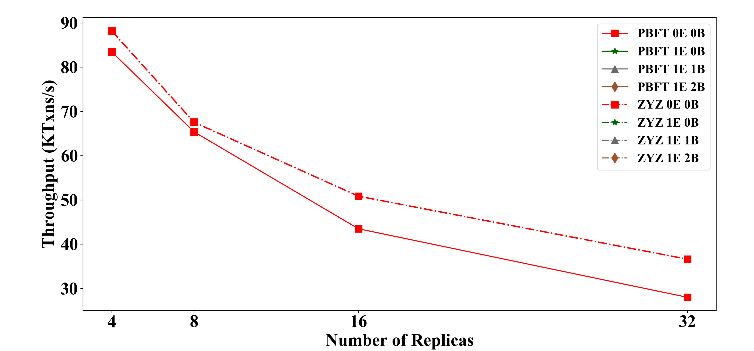
Insight 1: Multi-Threaded pipeline Gains
Parallelizing and Pipelining tasks across worker, execution (E) and batch-threads (B).

Slide 21
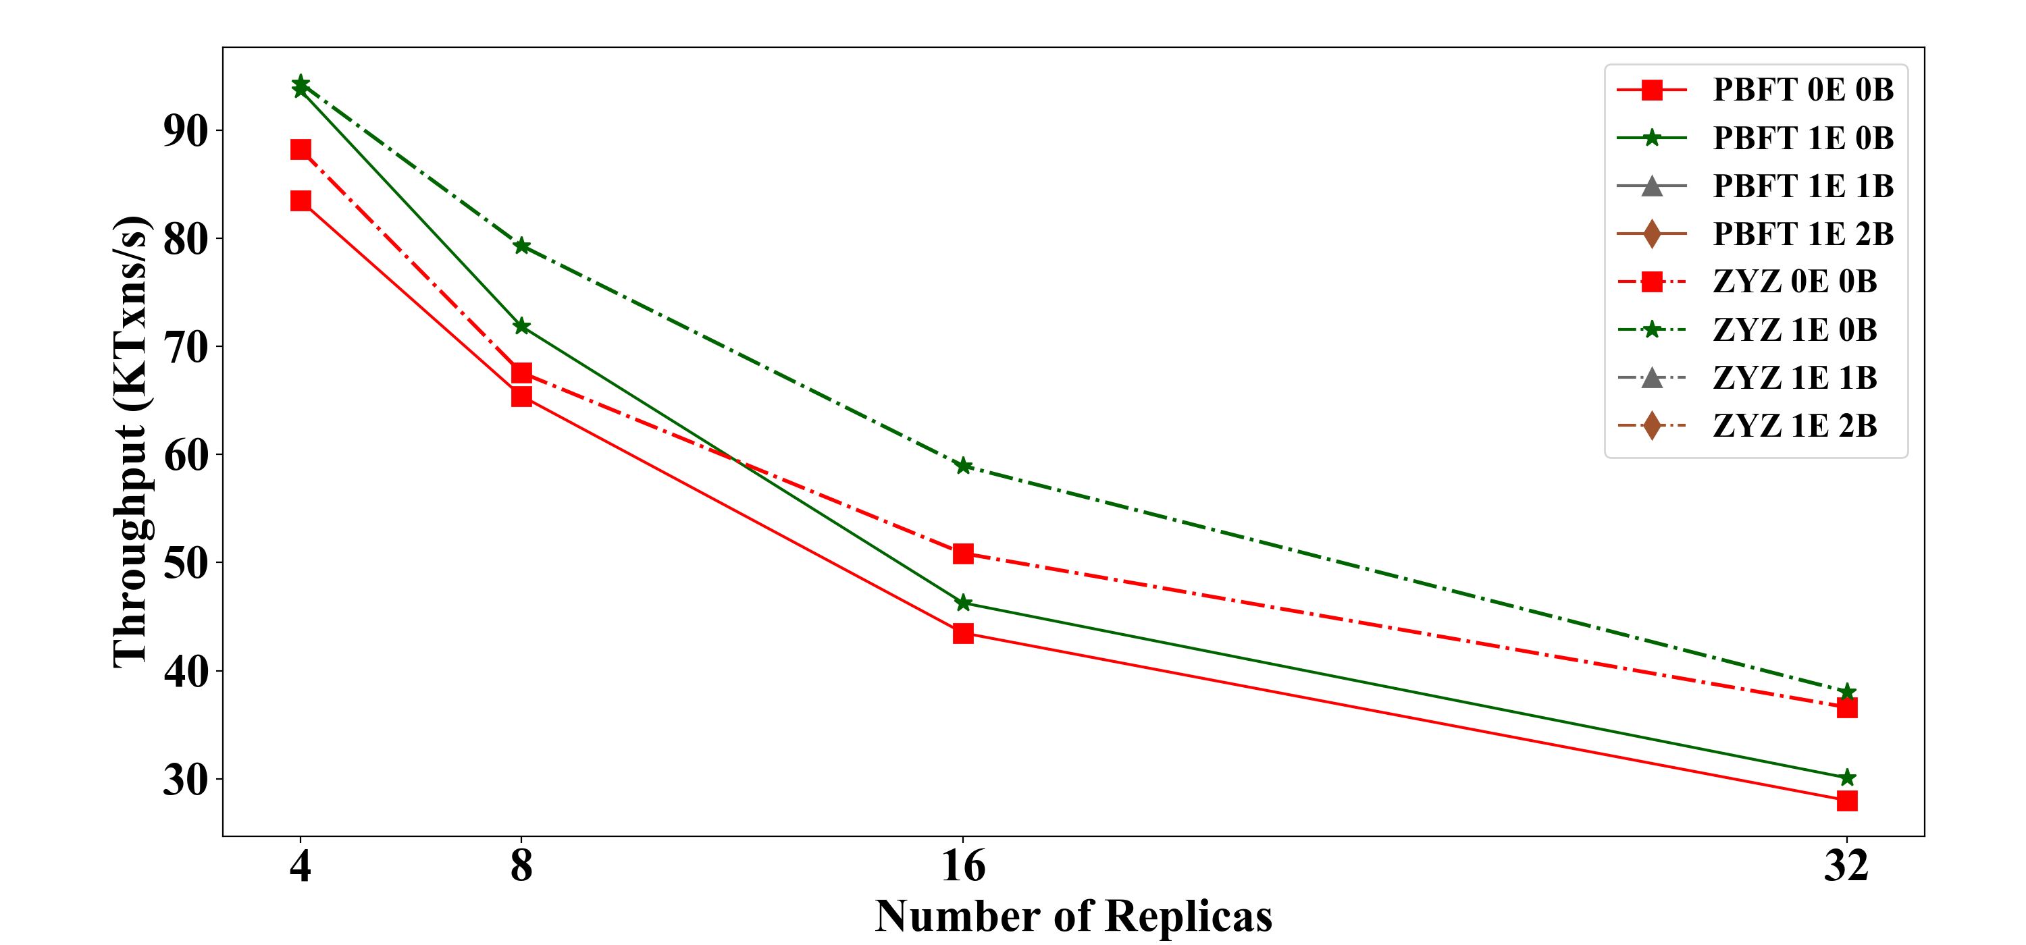
Insight 1: Multi-Threaded pipeline Gains
Parallelizing and Pipelining tasks across worker, execution (E) and batch-threads (B).

Slide 22
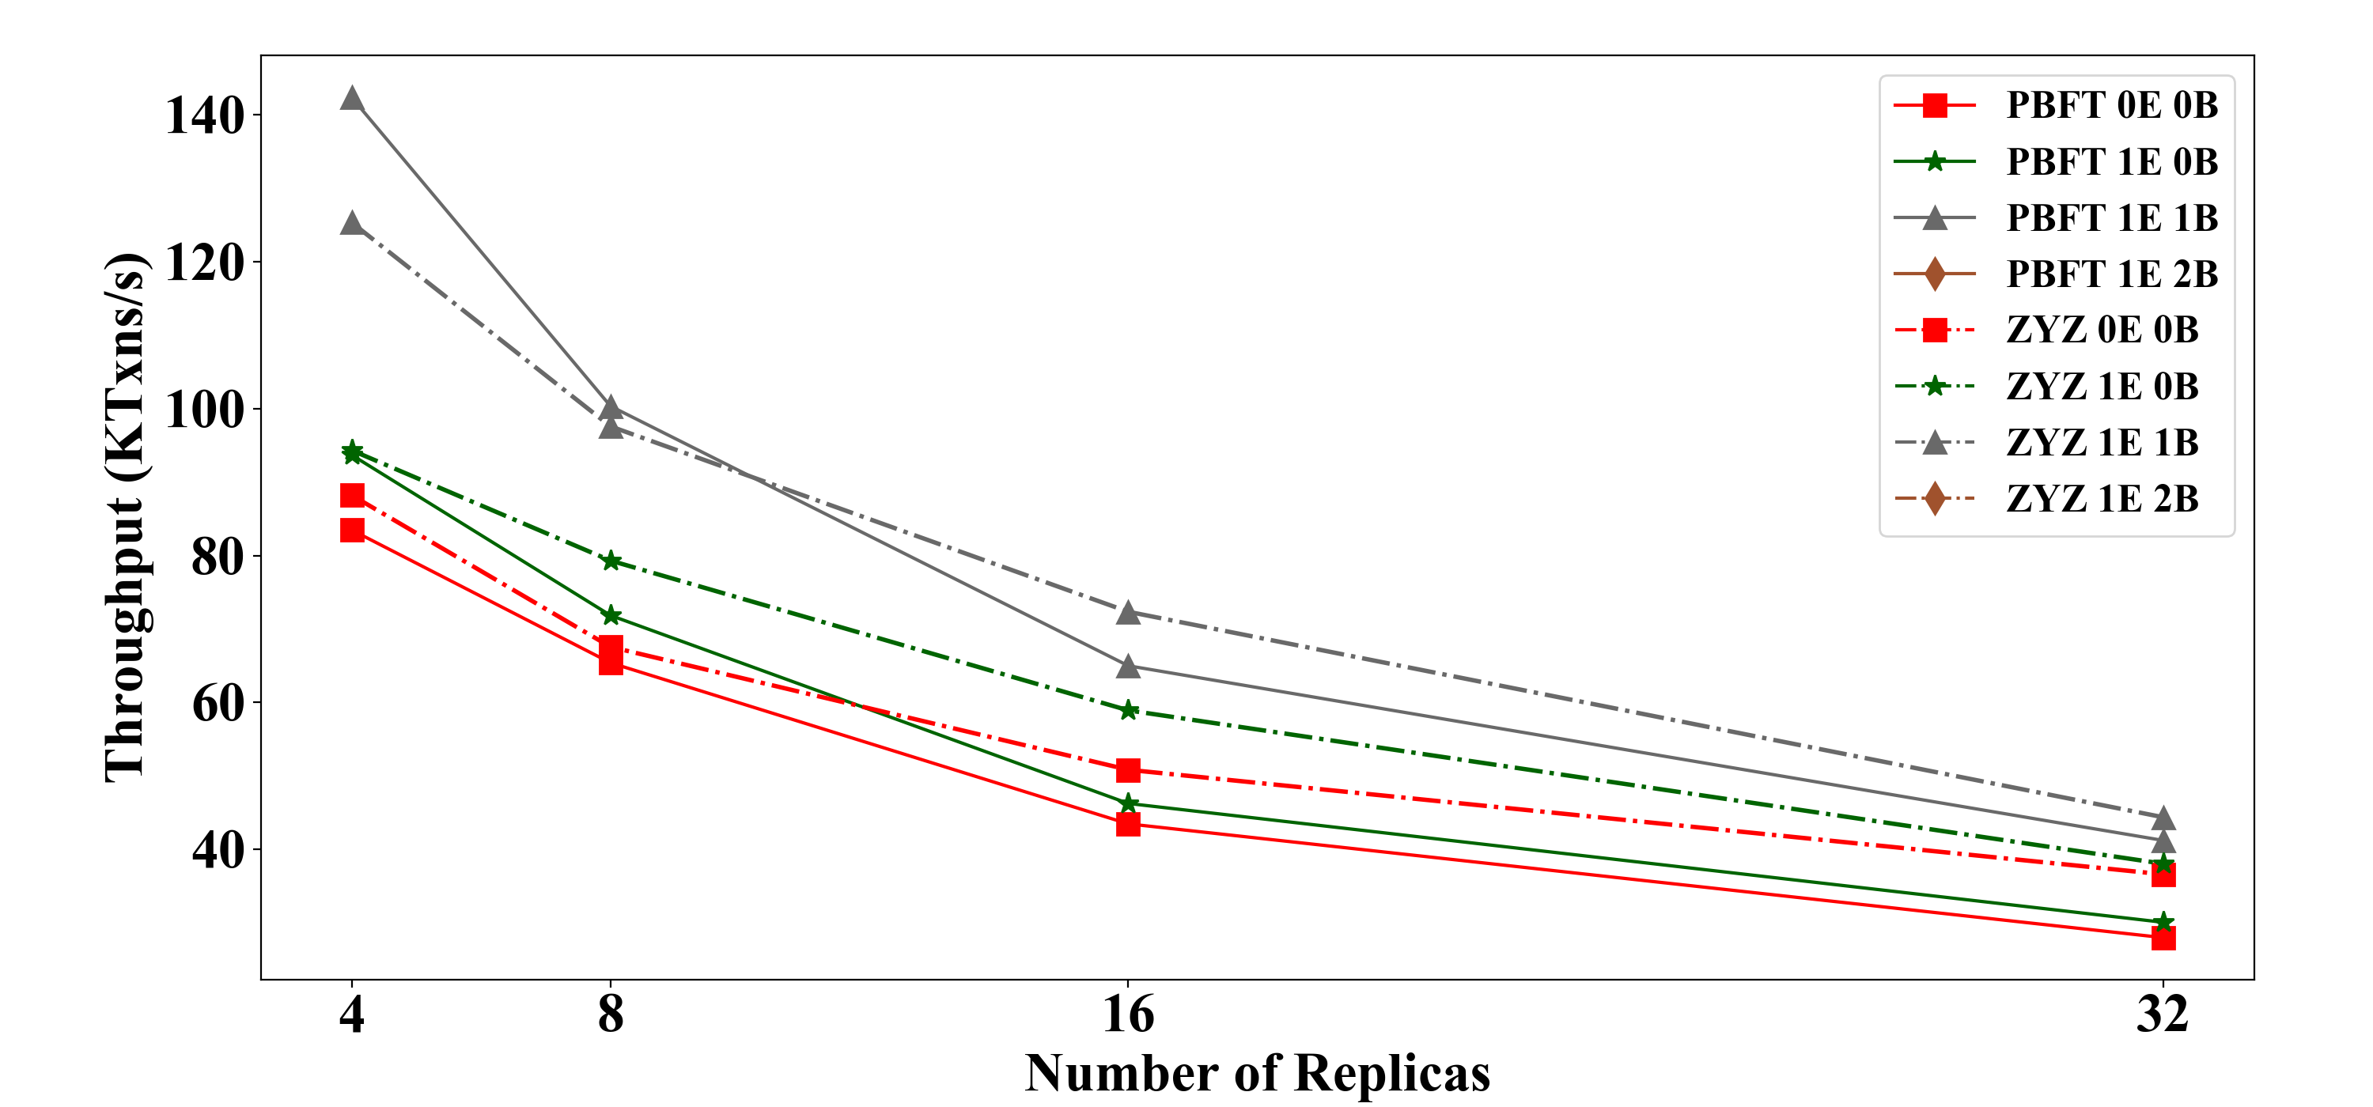
Insight 1: Multi-Threaded pipeline Gains
Parallelizing and Pipelining tasks across worker, execution (E) and batch-threads (B).

Slide 23
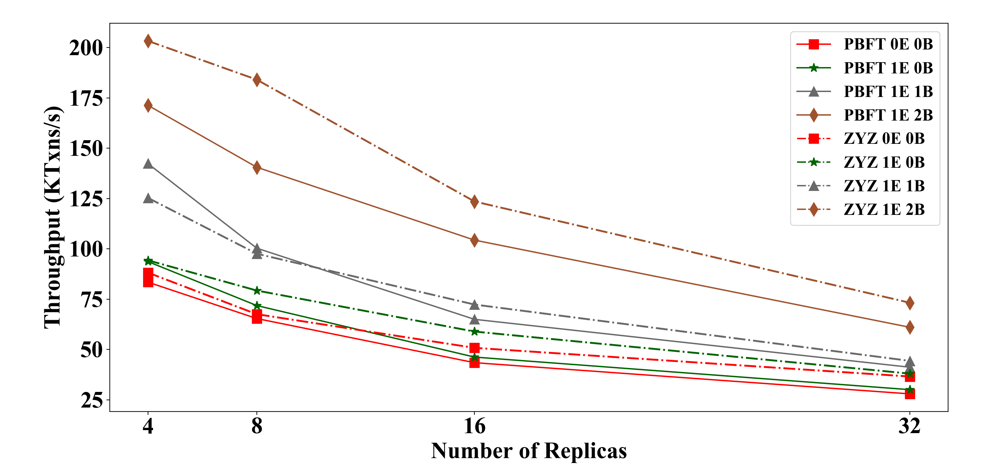
Insight 1: Multi-Threaded pipeline Gains
Parallelizing and Pipelining tasks across worker, execution (E) and batch-threads (B).

Slide 24
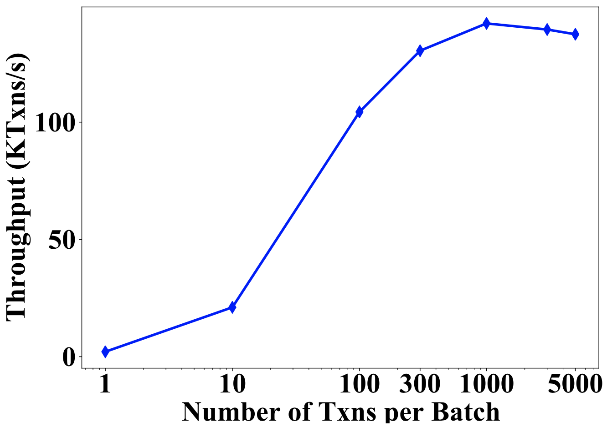
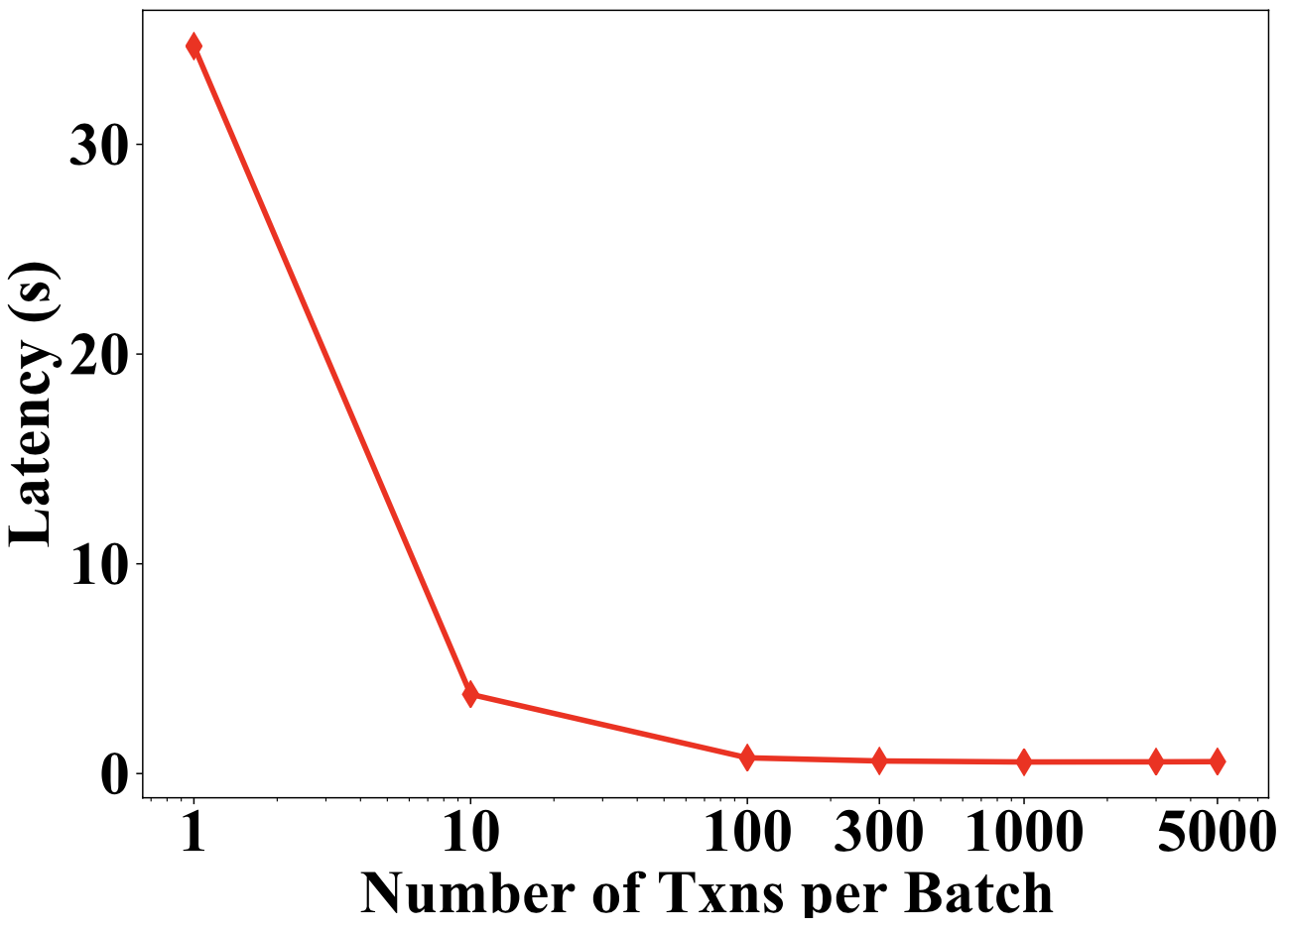
Insight 2: Optimal Batching Gains
More transactions batched together → increase in throughput
→reduced phases of consensus.

Slide 25
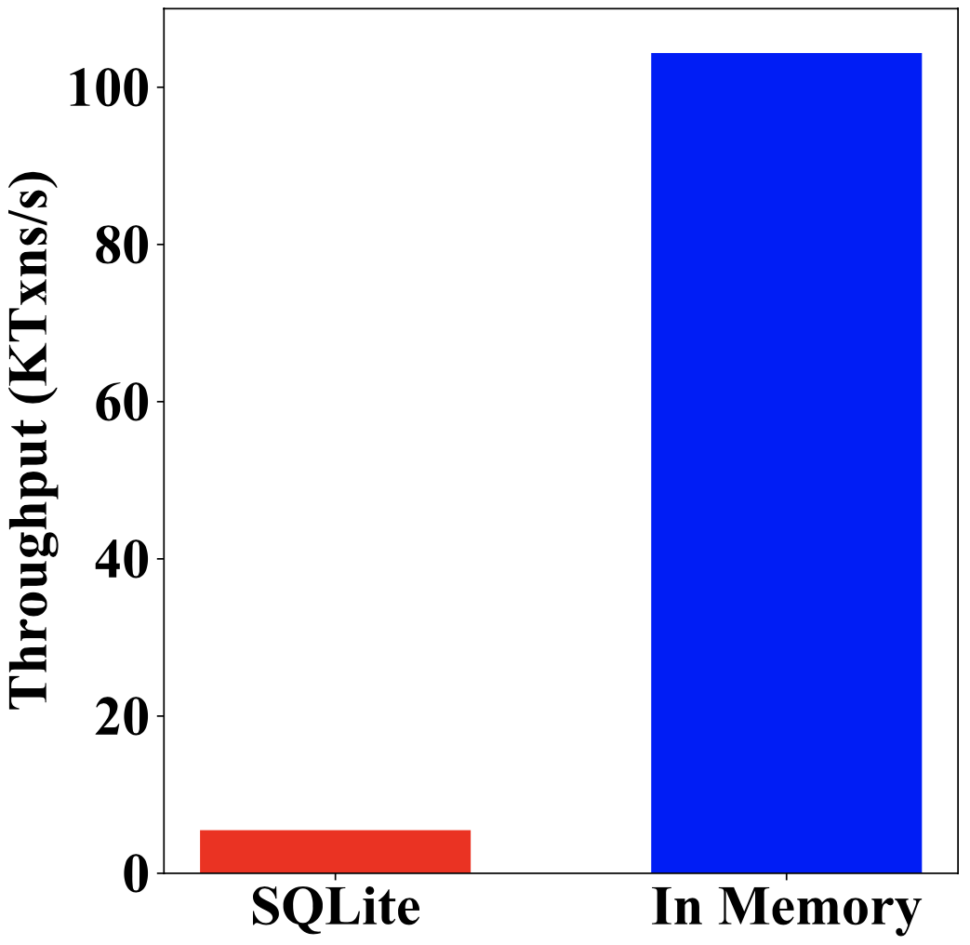
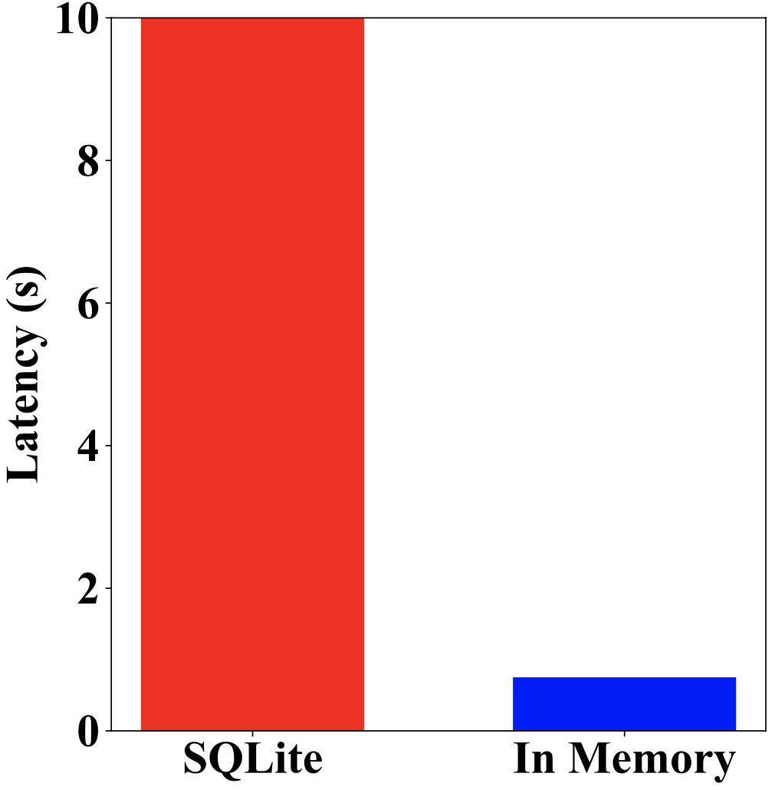
Insight 3: Memory Storage Gains
In-memory blockchain storage → reduces access cost.

Slide 26
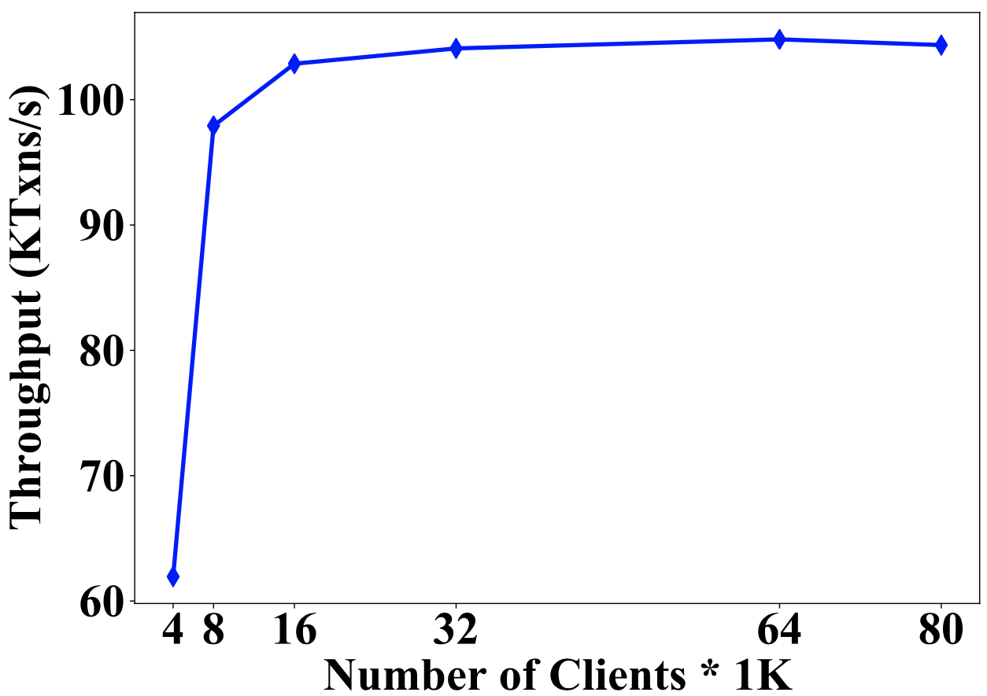
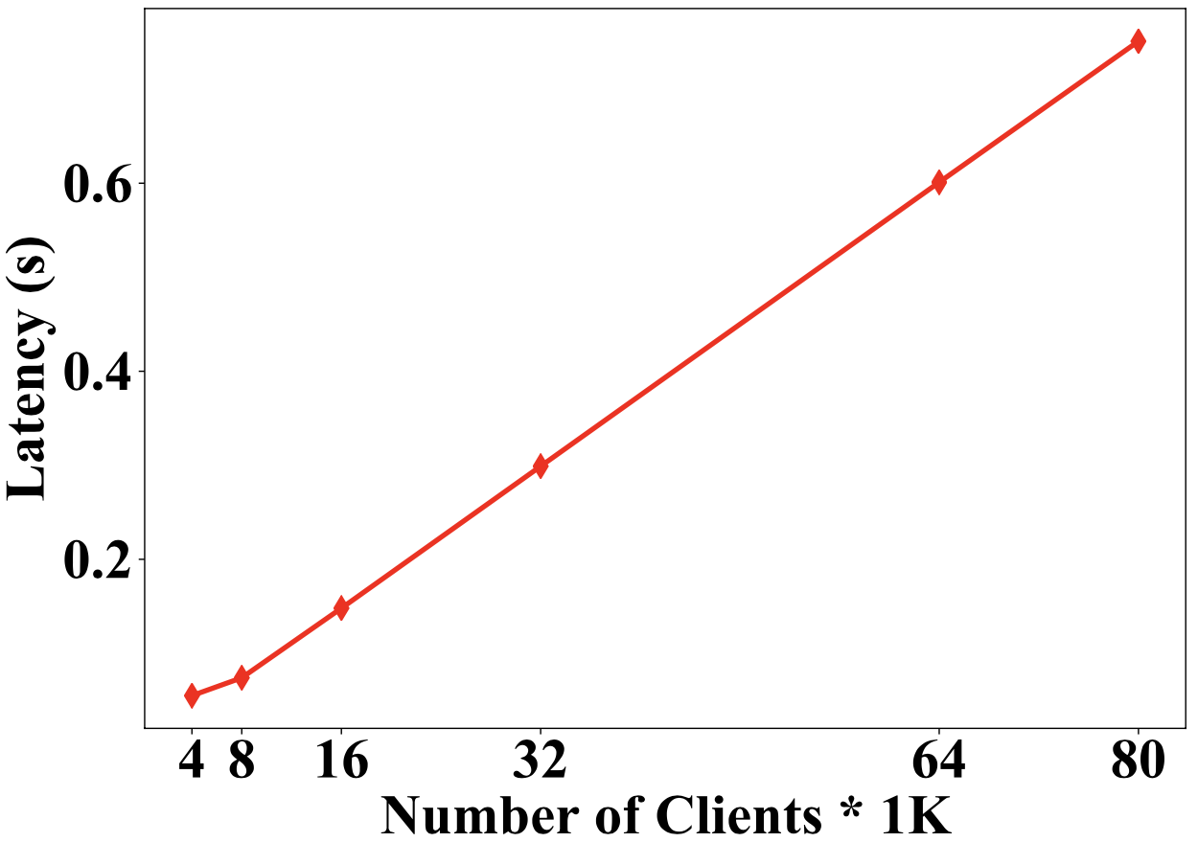
Insight 4: Number of Clients
Too many clients → increases average latency.

Slide 27
Insight 5: Optimal Cryptographic Scheme
Combining use of symmetric and asymmetric cryptography can improve system performance.

Slide 28
Conclusions and Final Remarks
There are several factors that affect throughput of a blockchain system.
Fast consensus does not always implies an efficient blockchain system.
We show that a well-crafted system-centric permissioned blockchain system can outperform a protocol-centric blockchain system.
System designers need to dissect their application to find performance bottlenecks.

Slide 29
References
S. Gupta, J. Hellings and M. Sadoghi, Fault-tolerant Distributed Transactions on Blockchain, Morgan & Claypool Synthesis Lectures on Data Management (to appear), 2020.
S. Gupta, J. Hellings and M. Sadoghi, RCC: Resilient Concurrent Consensus for High- Throughput Secure Transaction Processing, To appear in 37th IEEE International Conference on Data Engineering (ICDE). 2021.
S. Gupta, S. Rahnama and M. Sadoghi, Permissioned Blockchain Through the Looking Glass: Architectural and Implementation Lessons Learned, In 40th IEEE International Conference on Distributed Computing Systems (ICDCS). 2020.
S. Gupta, S. Rahnama, J. Hellings and M. Sadoghi, ResilientDB: Global Scale Resilient Blockchain Fabric, In 46th International Conference on Very Large Databases (VLDB). 2020 — Artifact Evaluated.
S. Gupta, J. Hellings and M. Sadoghi, Brief Announcement: Revisiting Consensus Protocols through Wait-free Parallelization, In 33rd International Symposium on Distributed Computing (DISC). 2019.
S. Gupta, J. Hellings, S. Rahnama and M. Sadoghi,Building High Throughput Permissioned Blockchain Fabrics: Challenges and Opportunities, In 46th International Conference on Very Large Databases (VLDB), 2020.
S. Rahnama, S. Gupta, T. Qadah, J. Hellings and M. Sadoghi, Scalable, Resilient and Configurable Permissioned Blockchain Fabric, In 46th International Conference on Very Large Databases (VLDB), 2020.

Slide 30
Thank You

